Slide 1
Intro to LevelDB
Zhenhua Zhang @FDG

Slide 2
What’s LevelDB?
KV store
  Put/get/del
Persist
  Disk based, low memory cost.
Log structure merging tree
  Sequential write, disk/ssd friendly.
Sorted keys
  SST tables, good for sequential read
Snapshot
  Versioning
Compression
  Data/key/Int

Slide 3
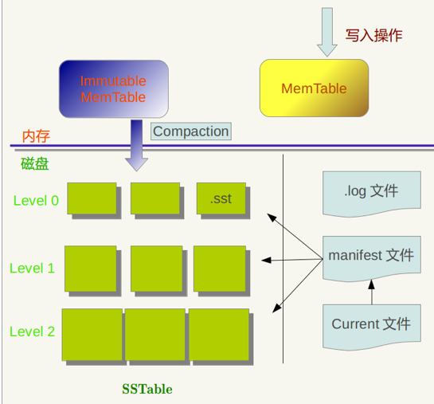
What does it look like?

Slide 4
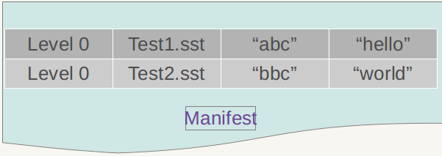
Manifest
Level structure
File location and metadata.
CURRENT file indicate which Manifest file is been used.

Slide 5
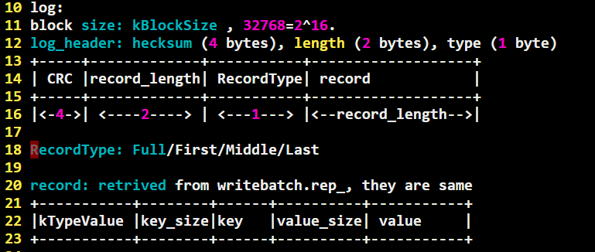
Log
Write log before writing memtable.
Crash recovery.

Slide 6
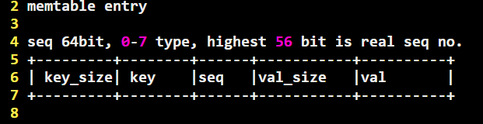
Memtable
Based on skiplist, LOC 384.
No delete, mark it.

Slide 7
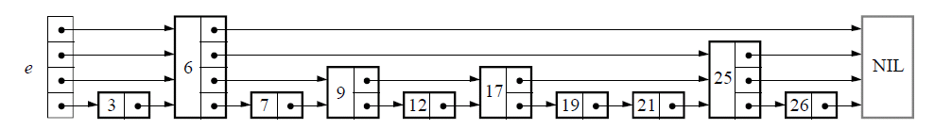
Skiplist
Random
LogN.

Slide 8
Arena
Optimization for small memory allocation.
Keep mallocing…free once.

Slide 9
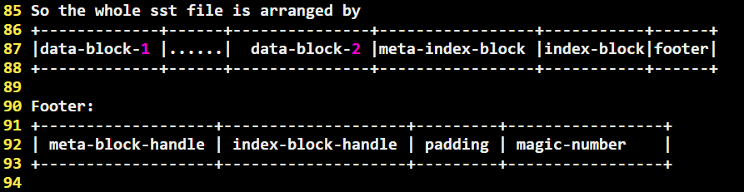
SST

Slide 10
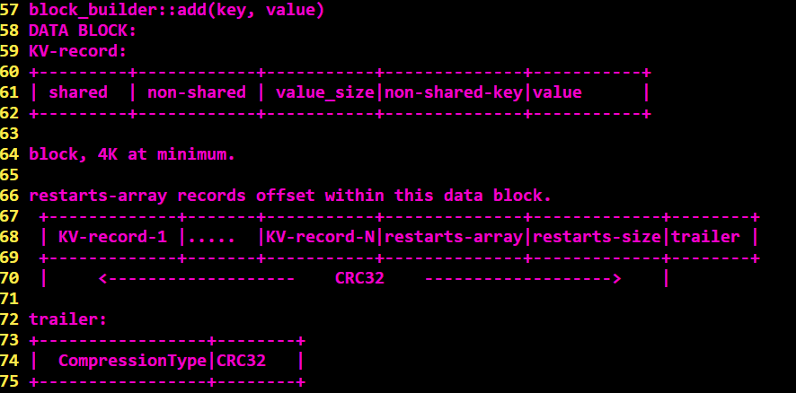
SST data block

Slide 11
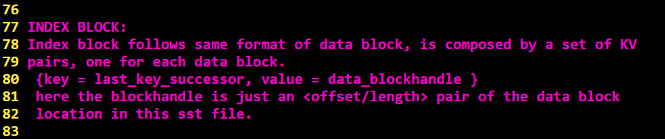
SST index block

Slide 12
Compaction – when?
GET.
Might set file_to_compact_.
Just build one immutable memtable
Open.
After applying log.

Slide 13
Compaction strategy
Defined in VersionSet::PickCompaction()
Compaction_score_:
L0: num_of_level_0_files / kL0_CompactionTrigger(default 4)
Ln: total_bytes_of_level_n / MaxBytesForLevel_n
  MaxBytesForLevel_n: level0/1=10M, level(i)=10M*10^(i-1).
File_to_compact_:
allowed_seeks == 0
allowed_seeks = max((f->file_size / 16384), 100)
Allowed_seeks -- if missed when looking up a sst file.

Slide 14
TODO
Filter
Iterator
Table cache

Slide 15
Variant
RocksDB@FB
Baidu: leveldb over OCF
Many more…

